Slide 1
ACCESS MODIFIERS

Slide 2
ACCESS MODIFIERS IN JAVA
Restrict the scope of a class, constructor, variable, method or data member.
It can be specified separately for a class, constructors, fields, and methods.
It referred as Java access specifiers, but the correct name is Java access modifiers

Slide 3
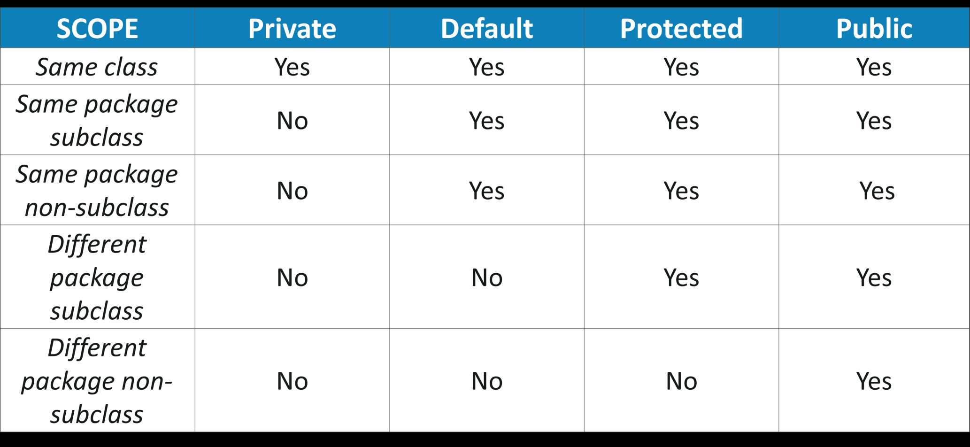

Slide 4
Private:
Access level is only within the class.
It cannot be accessed from outside the class.
Default:
Access level is only within the package.
Cannot be accessed from outside the package.
If you do not specify any access level, it will be the default.

Slide 5
Protected:
Access level of is within the package and outside the package through child class.
If you do not make the child class, it cannot be accessed from outside the package.
Public:
Access level is everywhere.
Accessed from within the class, outside the class, within the package and outside the package.

Slide 6
EXAMPLES

